Slide 1
Week 2: CSS Foundations

Slide 2
Agenda
CSS Basics
Inline vs. Embed vs. External Styles
How it works
CSS Anatomy
CSS Selectors: elements, id, class
CSS Comments
CSS Properties
In-Class Demo
Homework

Slide 3
CSS Basics

Slide 4
CSS Basics
What is CSS?
Stands for Cascading Style Sheet
Unlike HTML which is a markup language, CSS is a presentation language
CSS takes the HTML markup and style its content so that they are more presentable to the viewer
CSS can style just about anything that’s on a web page – it can colorize, change, scale, reveal/hide, move contents and many more.
Current version: CSS3

Slide 5
Inline vs. Embed vs. External Styles

Slide 6
Inline vs. Embed vs. External Styles
There are 3 ways where you can write CSS codes:
Inline or Local
Embed or Internal
External

Slide 7
Inline vs. Embed vs. External Styles
Inline or Local
Codes are embed within HTML open tags using the style attribute. Example:
<p style="color: red; font-weight: bold">
Advantages:
Quick to write
Ability to overwrite global styles
Disadvantages:
Time consuming to maintain codes as they are spread throughout HTML file and files
Duplication of codes on same HTML file and also across multiple HTML files
Inflexibility for future changes
The least preferred way of writing CSS.

Slide 8
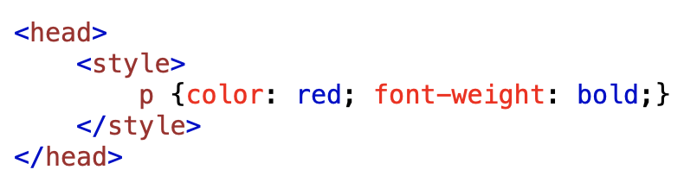
Inline vs. Embed vs. External Styles
Embed or Internal
Codes are group in one specific area of the HTML file – within the <head> area using the style element. Example:
Advantages:
Organized and easy to maintain codes
Disadvantages:
Duplication of codes – similar codes repeated on multiple HTML files
Time consuming to make code changes – need to chase down codes on multiple files

Slide 9
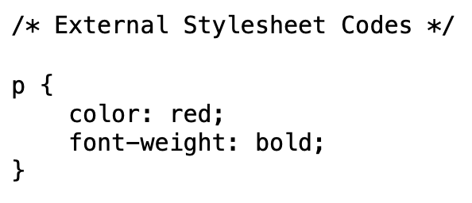
Inline vs. Embed vs. External Styles
External
Codes are grouped in one document saved as a separate file. There are 2 things you need to do:
A separate file containing css codes saved in css extension (example: styles.css)
Example of what’s in the styles.css file:

Slide 10
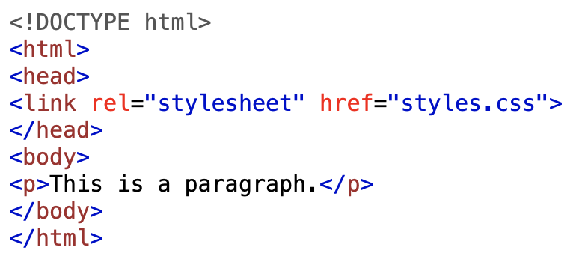
Inline vs. Embed vs. External Styles
External
Link the css file to the HTML file(s). Example:
Advantages:
Faster code changes – results in immediate global site updates
One stop code maintenance
Disadvantages:
Risk loss of stylesheet file
Could result in a mix use of 2 or more methods that could complicate the order of styles

Slide 11
How it Works

Slide 12
How it Works
CSS brings style to web pages by calling HTML elements. Elements are those HTML markup on a web page—for instance paragraph—which, if you recall in HTML look like this:
<p>This is a paragraph.</p>
So if you want to make this paragraph appear red and bold to visitors viewing your web page on a web browser, your CSS code would look like this:
p { color:red; font-weight:bold; }

Slide 13
CSS Anatomy

Slide 14
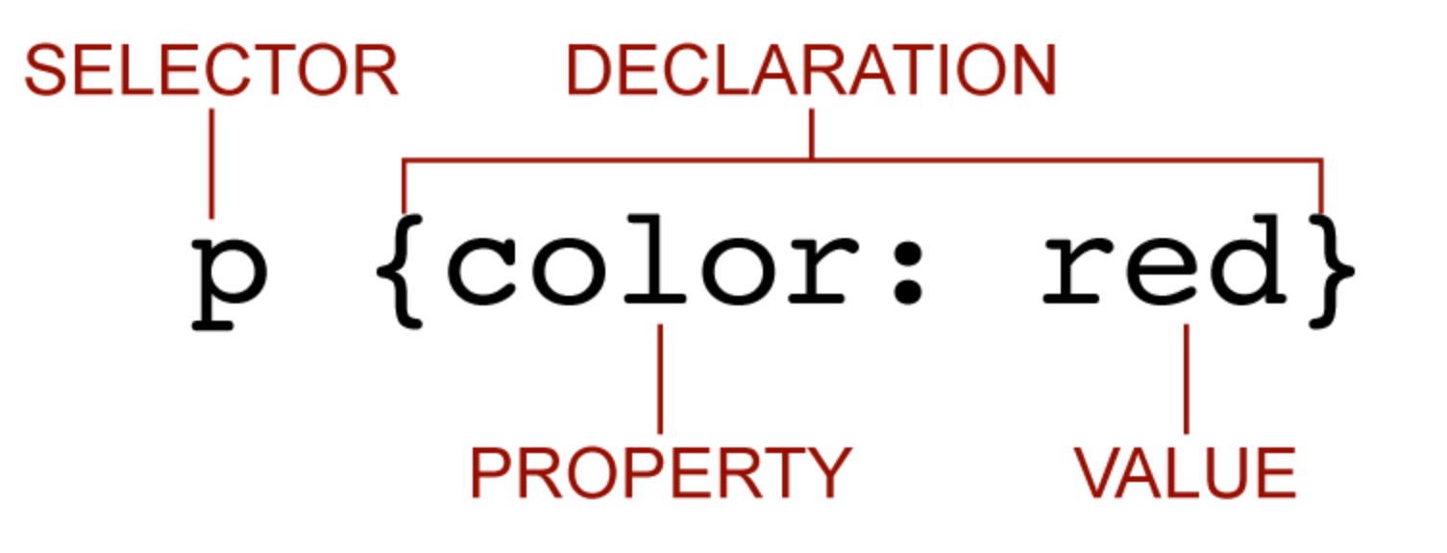
CSS Anatomy
Let’s take a closer look at how CSS is structured, ie. its anatomy:
So how many rules can one write using inline, embed or external stylesheet?
Answer: as many as you need, but should not have more than one rule with the same selector.
The above structure is refer to as a CSS Rule

Slide 15
CSS Selectors: elements, id, class

Slide 16
CSS Selectors: elements, id, class
What is CSS Selector?
It’s the part of a CSS rule set that selects the content on the HTML document that you want to style.
These are the main types of selectors commonly used to select content on a HTML document:
elements
id
class

Slide 17
CSS Selectors: elements, id, class
Elements:
HTML elements that currently exist on the document
Example: body, h1..h6, p, a, img, ol, ul, li, div, span, header, nav, main, footer
How to use: h1 { font-family: arial} or p {color:red}
id:
id attribute of HTML elements that currently exist on the document
Example: <body id="home"> or <p id="quote">
How to use: #home {font-family: arial} or #quote {color:red}

Slide 18
CSS Selectors: elements, id, class
class:
class attribute of HTML elements that currently exist on the document
Example: <header class="logo"> or <a class="active">
How to use: .logo { width: 0.95em} or .active {color: #ff00ff}
Other selectors: attribute
attribute of HTML elements that currently exist on the document
Example: <img alt="London Bridge Photo">
How to use: img[alt] { width: 1.5em} or [alt] {width: 1.5em} or
[alt="London Bridge Photo"] {width: 1.5em}

Slide 19
CSS Comments

Slide 20


CSS Comments
Comments are used in CSS to explain a block of code or to make a CSS code inactive. The commented code are ignored by browsers.
There 2 types of CSS comments: single line and multi-line
Single Line example: //your comments written on one line
Multi-Line example: /* your comments are
written on multiple
lines */
It is a industry standard practice to use comments in web development

Slide 21
CSS Properties

Slide 22
CSS Properties
As seen in a CSS anatomy, property is part of a CSS rule. Property is a particular CSS style that dictates how a HTML element and/or its content can visually look. You cannot create your own properties. A list of properties are already pre-written and available for developers to use.
Below are some of the most common properties used:
color
background-color
background-image
font-family
font-size
font-weight
text-align
border
margin
padding
float
list-style
width
height
text-decoration
For a comprehensive list of properties, visit https://www.w3schools.com/cssref/

Slide 23
Resources
https://www.w3schools.com/html/html_tables.asp
https://developer.mozilla.org/en-US/docs/Learn/HTML/Tables/Basics
https://html.com/tables/
https://www.w3schools.com/html/html_forms.asp
https://www.tutorialspoint.com/html/html_forms.htm
https://developer.mozilla.org/en-US/docs/Web/HTML/Element/form

Slide 24
Questions?

Slide 25
Connect with Us (WEB801)
Professor
Teaching Assistant
Teaching Assistant
Teaching Assistant
Rich Loke
richloke@westcliff.edu
Reshae Alagbada
reshaealagbada@westcliff.edu
Elizabeth Kipp
elizabethkipp@westcliff.edu
Jonas Restad
jonasrestad@westcliff.edu
Slack: spring2021s3-bootcamp-mon

Slide 26
Connect with Us (WEB301 & WEB501)
Teaching Assistant
Teaching Assistant
Professor
Ilya Valasov
ilyavalasov@westcliff.edu
Christopher Paul
christopherpaul@westcliff.edu
Teaching Assistant
Teaching Assistant
Ghani Zahid
ghanizahid@westcliff.edu
Slack: spring2021s3-bootcamp-tue
Nico Lauria
nicolauria@westcliff.edu
Yi Sun
yisun@westcliff.edu

Slide 27
End of Presentation

